Slide 1
Project Proposal - Robotics and Engineering
Idea:
AI that finds and tunes PID values during runtime
NOTE: this project is ongoing! I will update this slides as I’ll progress

Slide 2
The problem
Most closed-loop control systems use a system called PID: a system that takes the error value and corrects it over time.
The main problem with this system is that it requires manual adjustment of parameters, which can take a lot of time and resources.

Slide 3
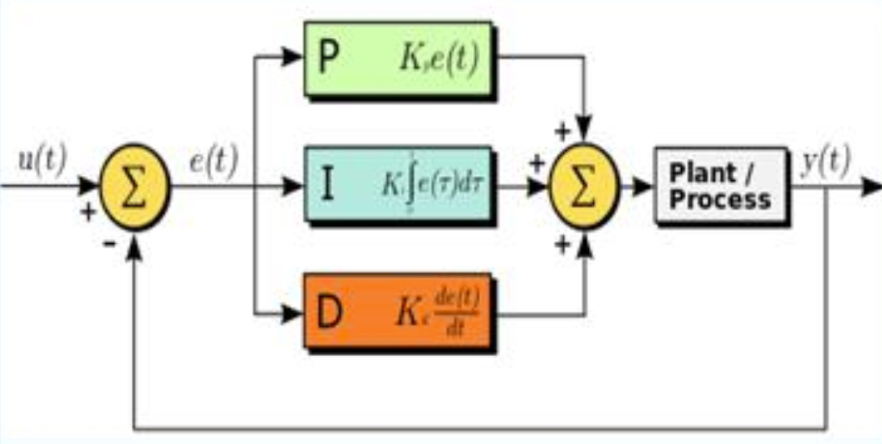
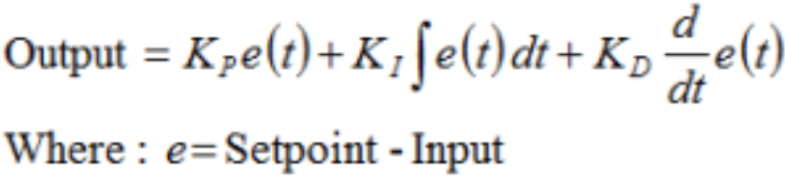
Explanation of the PID system
PID: (proportional, integral, derivative)
A continuous closed-loop navigation control algorithm. This algorithm uses the output error of an operation to adjust and correct it, thereby maintaining stability and accurately achieving the desired target.

Slide 4
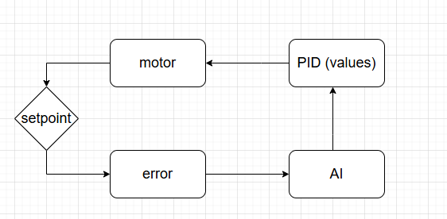
Solving the problem - Neuro PID
We inserted a neural network with the following characteristics into the PID loop:
Input: Error values, previous values, set point (target point)
Output: Ki, Kp, Kd values (PID parameters)
The AI learns while running, which means it accurately adjusts the values during operation. This ability allows the AI to adapt to any system, thereby reducing the time it takes to find parameters manually.

Slide 5
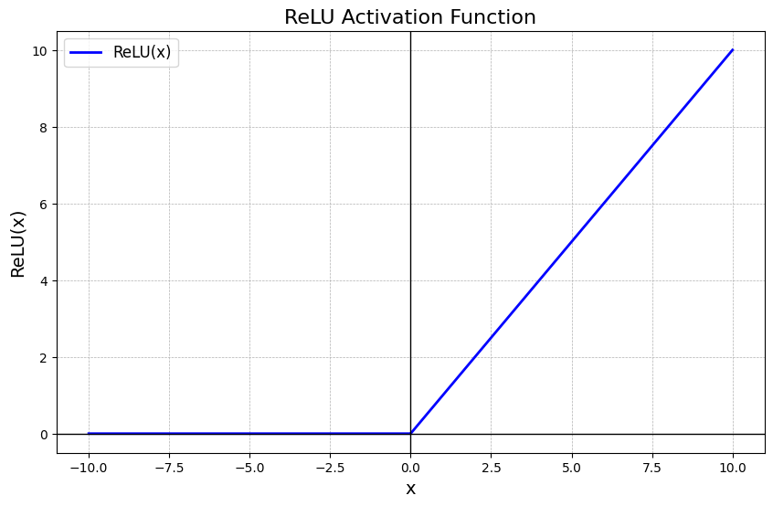
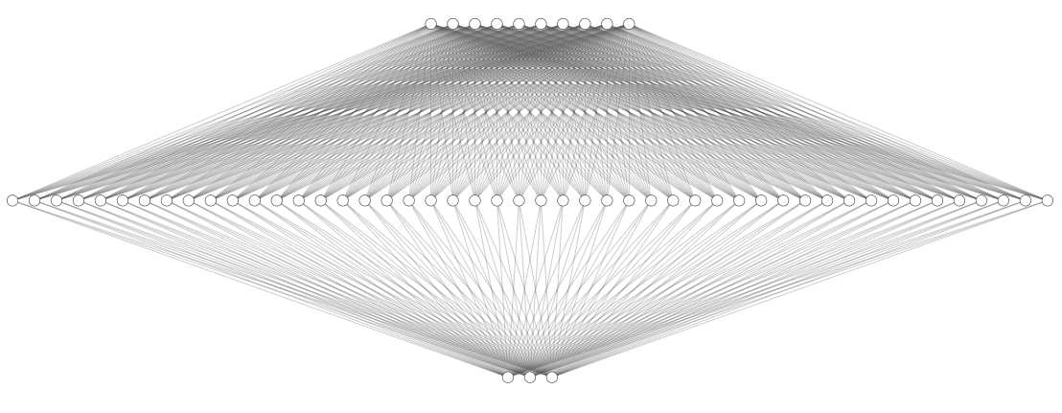
About the AI
A neural network that operates on the principle of unsupervised learning - the system aims to reduce the error value instead of learning from existing data. The lower the error, the higher the "reward" the AI receives. The network's calculation time within the controller is less than a nanosecond (instantaneous).
The network uses an activation function (the algorithm by which the network calculates) called ReLU.
Image of the neural network

Slide 6
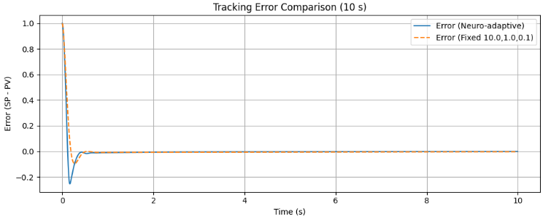
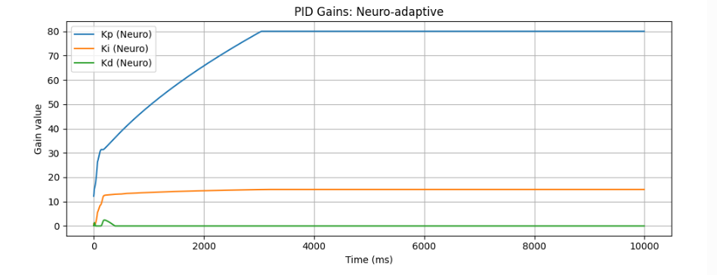
Results:
Note: this is a simulation
The system has yet to be tested in the real world

Slide 7
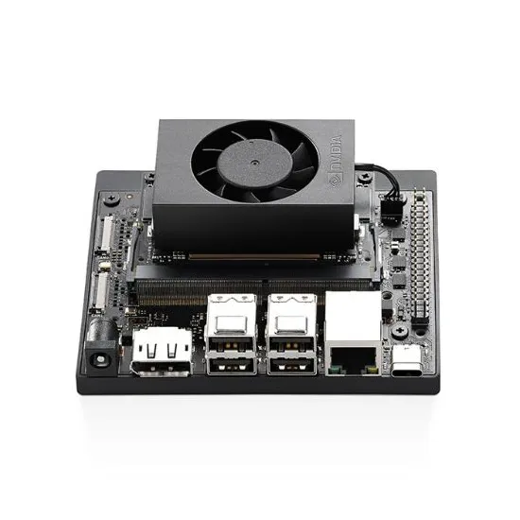
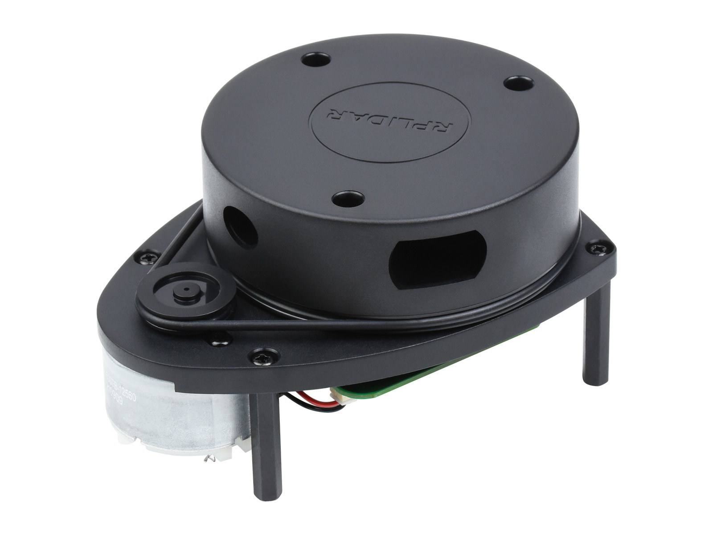

A conceptual description of the system
Jeton Orin Nano Super as a controller
LiDAR. Connected using the UART (TX RX) and/or USB protocol.
Uses the neuro PID on the distance to correct deviations and inaccuracies.
Using ROS to synchronize all components

Slide 8
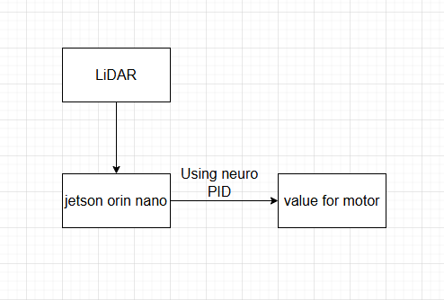
A block diagram of the system

